Slide 1

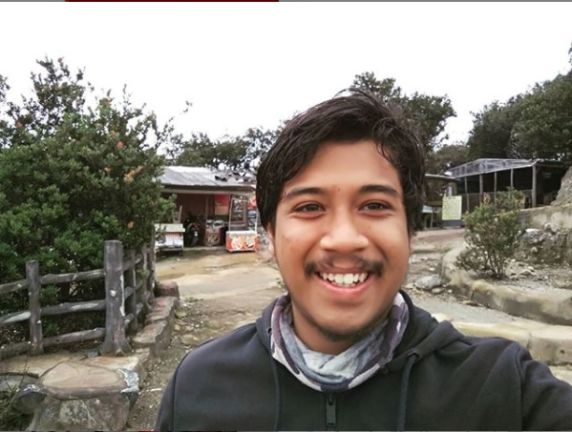
Blynk app. Widget box, digital pin, virtual pin, and additional setting
Content :
Install blynk legacy
Create project and get authentication code
Widget box, blynk token
Digital pin + virtual pin
Direct control and buffered control
SMKDT’s IoT Expo layout benchmark
Make SMKDT IoT Team group
Integrate All system per group
Speaker : Muhammad Husni, S. Pd
Python Programmer
Alumni SMKDT Angkatan 4 (Geist In Vier)

Slide 2
About me
Name : Muhammad Husni Muttaqin, S. Pd.
Birth date : 5 June 1998
Hometown : Bandung
Current Job : Python programmer at PT Syergie Indoprima
Experiences : - 2019 : Dynamics Positioning System control system engineer on cable ship kalibaru – untung jawa 20Kv cable installation (PT Syergie Indoprima)
- 2019 : Dynamics Positioning System control system engineer on cable ship lampung – pahawang 20Kv cable installation (PT Syergie Indoprima)
- 2020 : Dynamics Positioning System control system engineer on cable ship palapa ring tengah cable maintenance (PT Syergie Indoprima)
- 2021 - 2022 : Electronics and control system engineer for Vent-I (PT Syergie Automa Teknologi)
- 2022 : python programmer

Slide 3
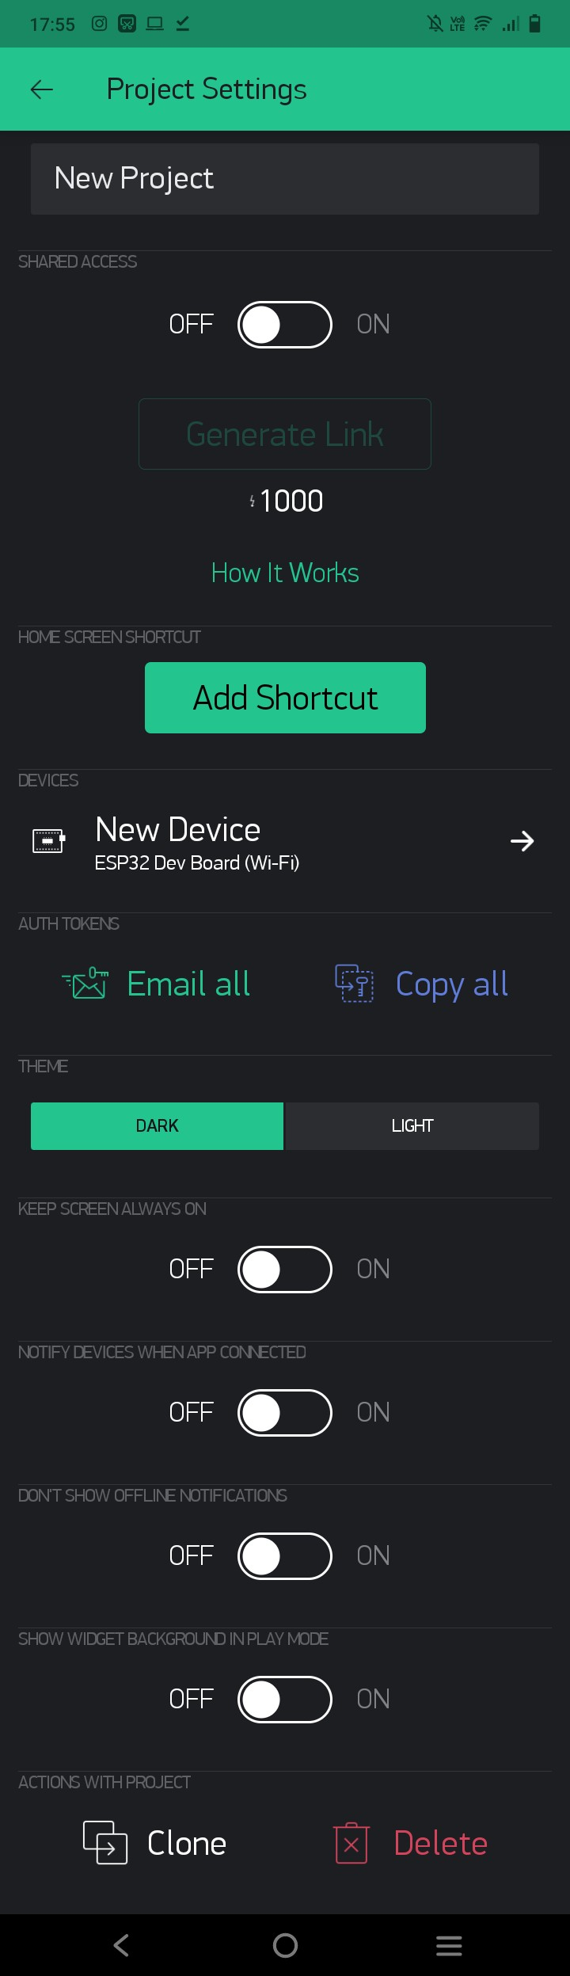
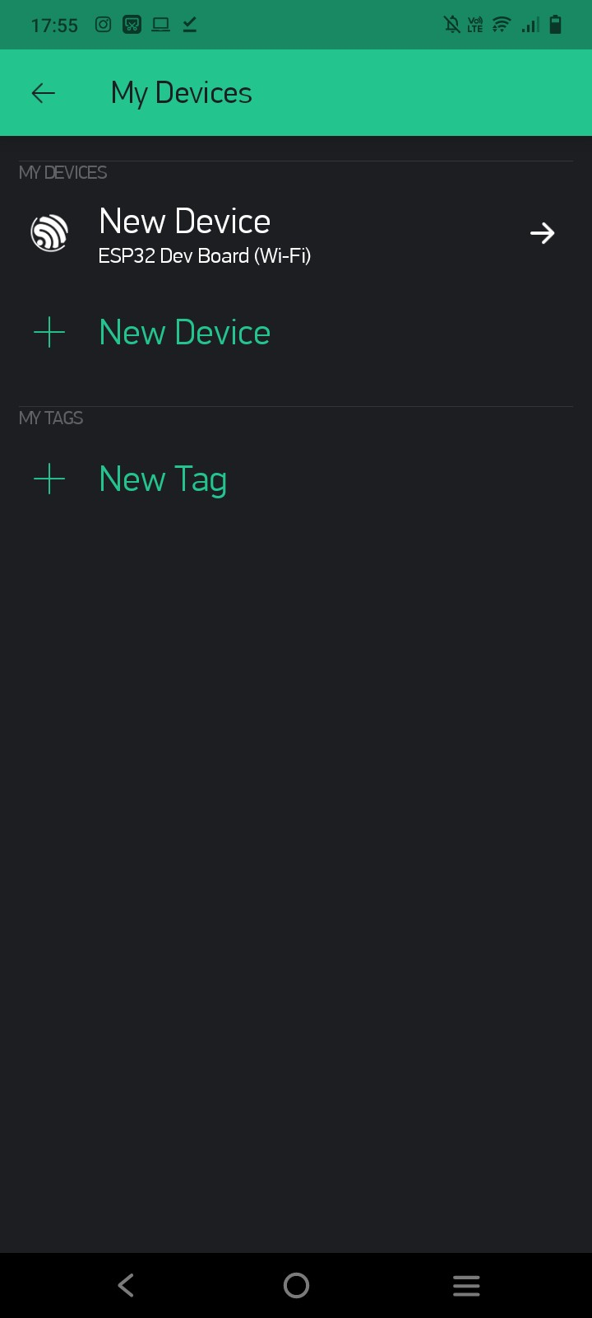
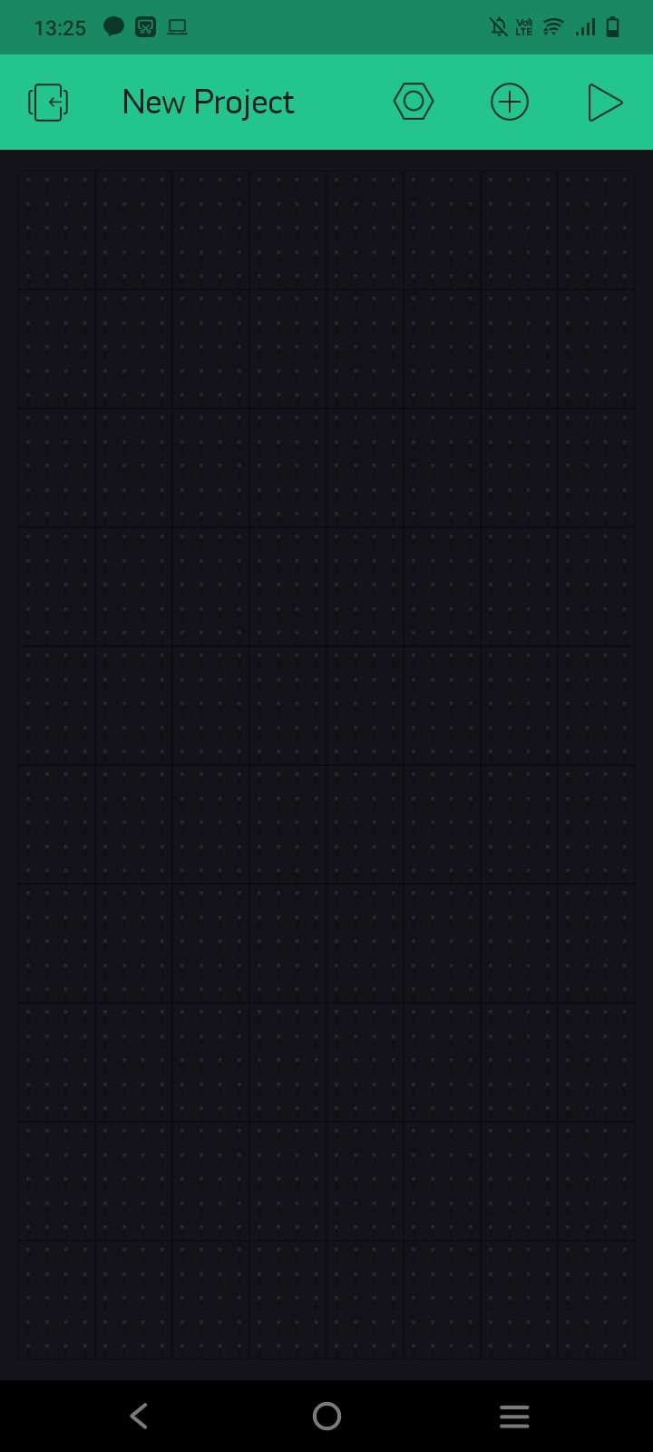
Create new project and get authentication code

Slide 4
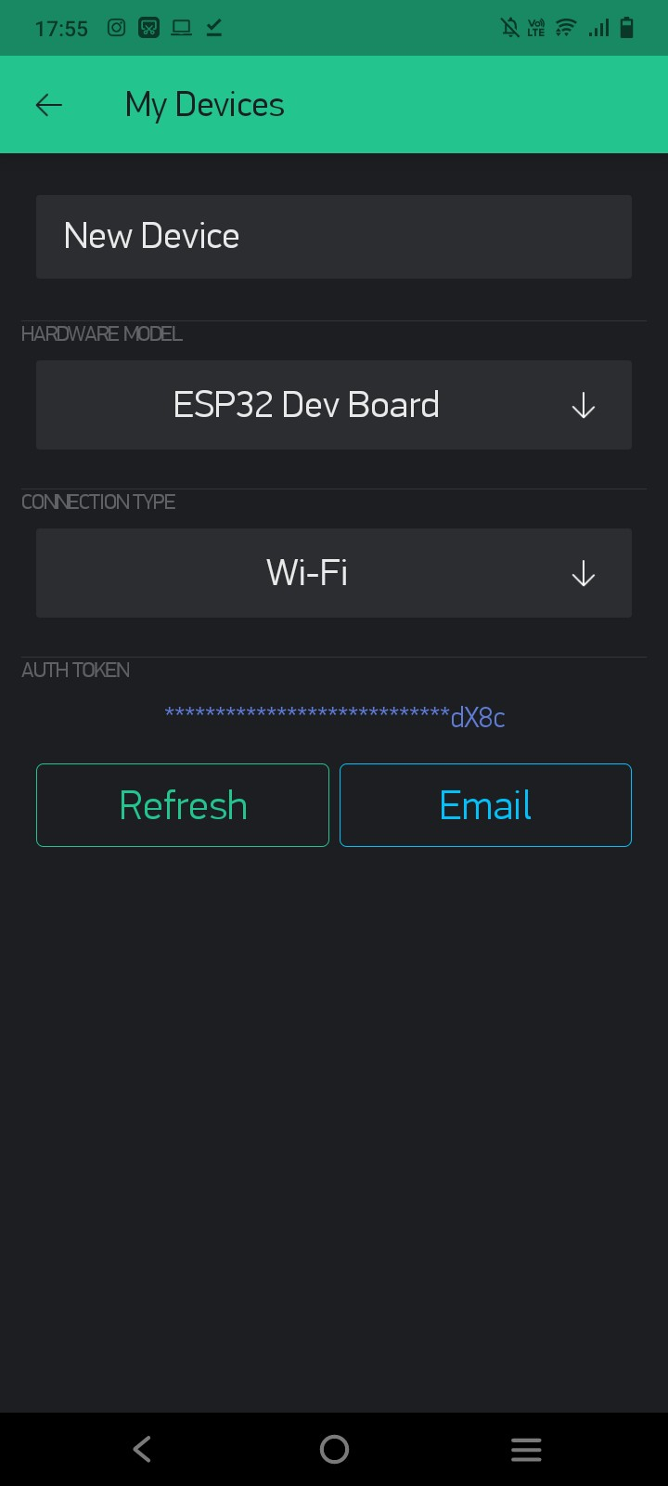
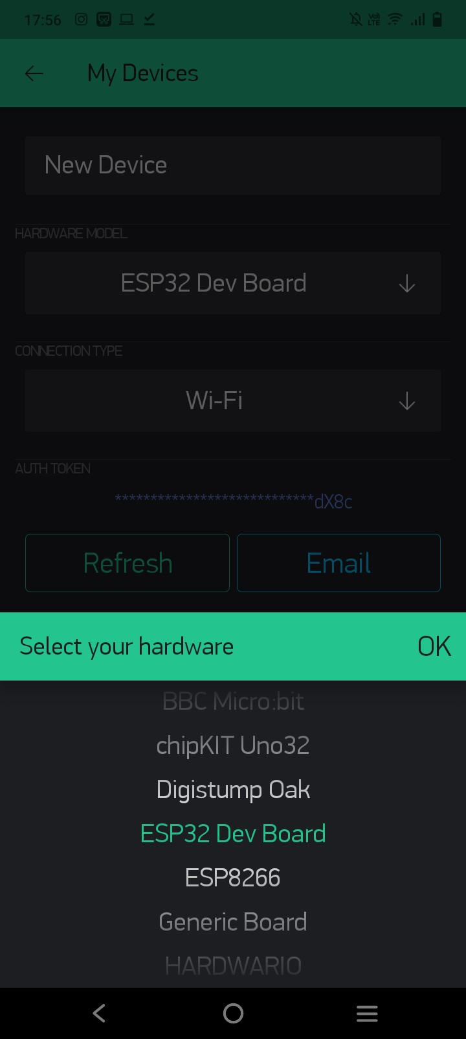

Slide 5
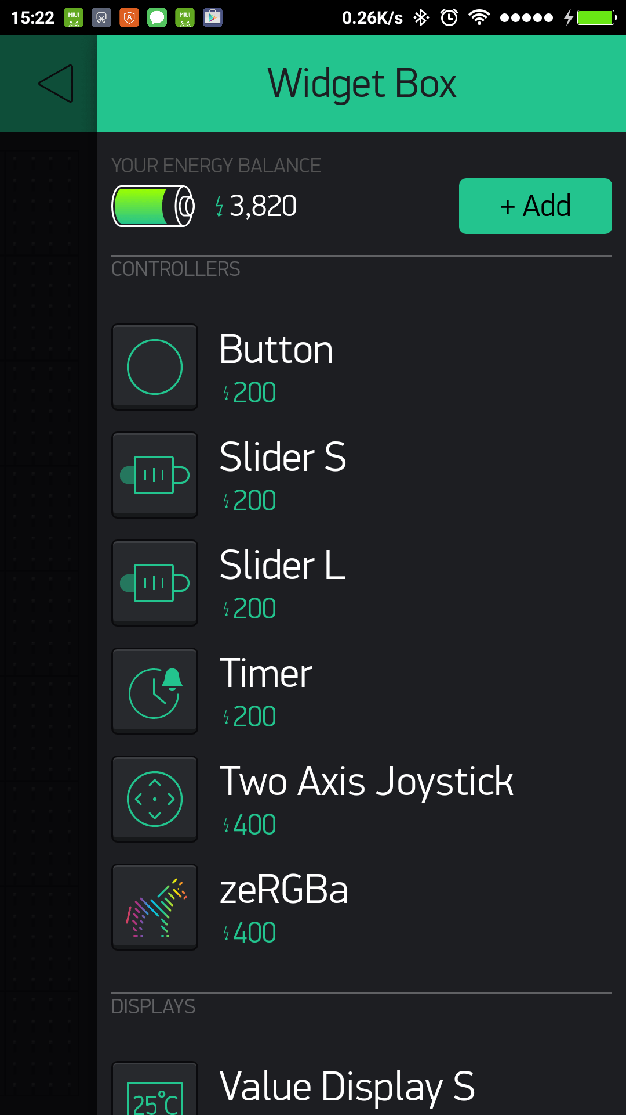
Widget box, blynk token
Blynk Token
WIDGET BOX

Slide 6
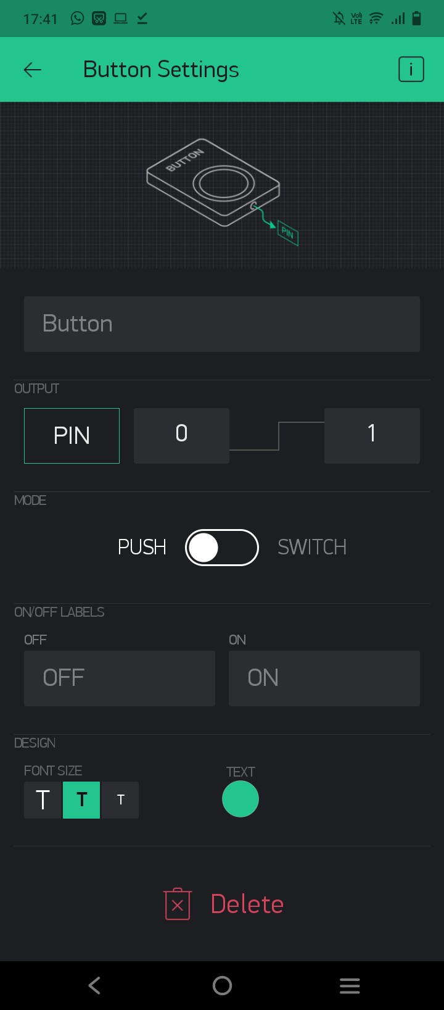
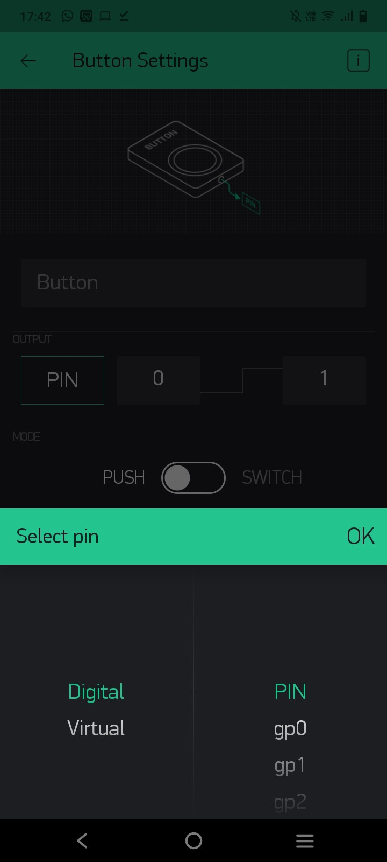
How to use blynk widget
Button :

Slide 7
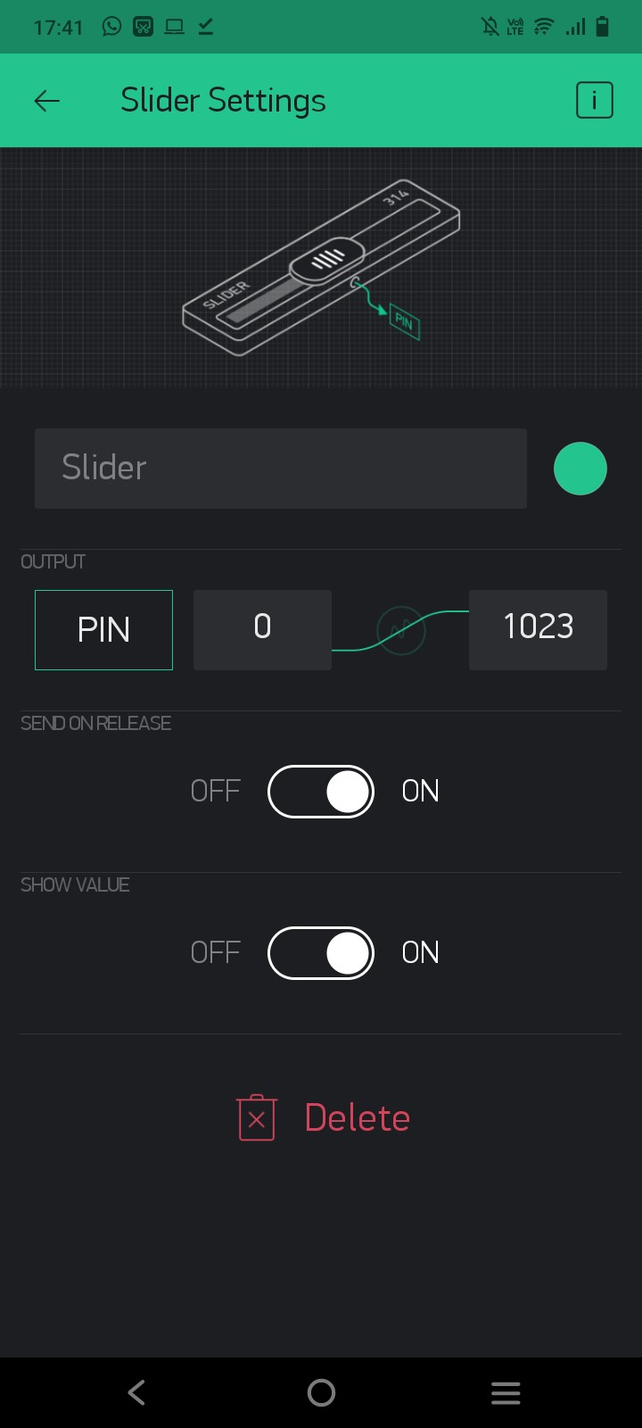
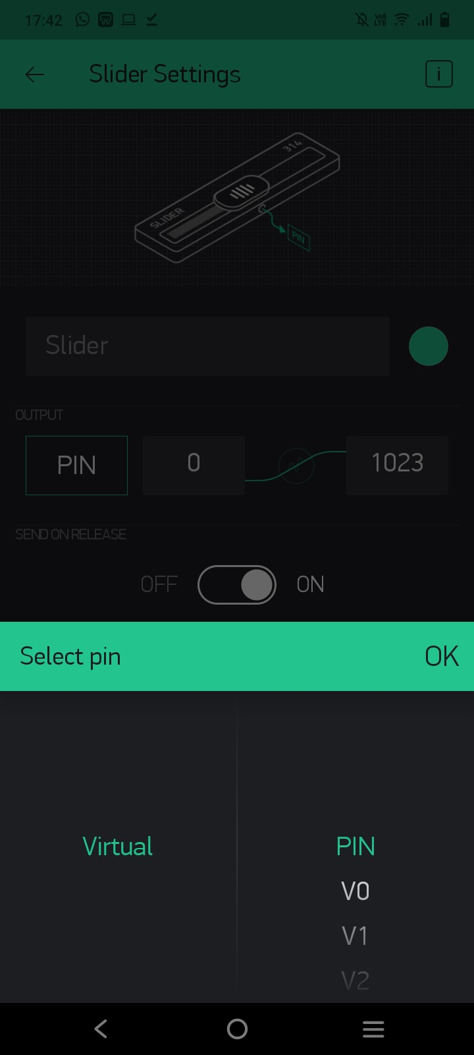
How to use blynk widget
slider

Slide 8
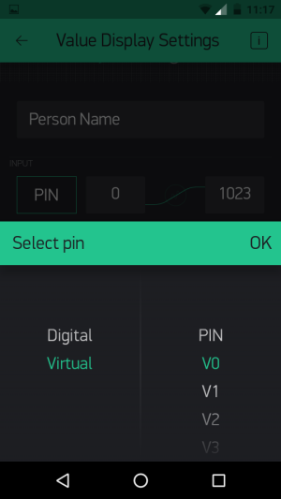
Digital pin + virtual pin

Slide 9


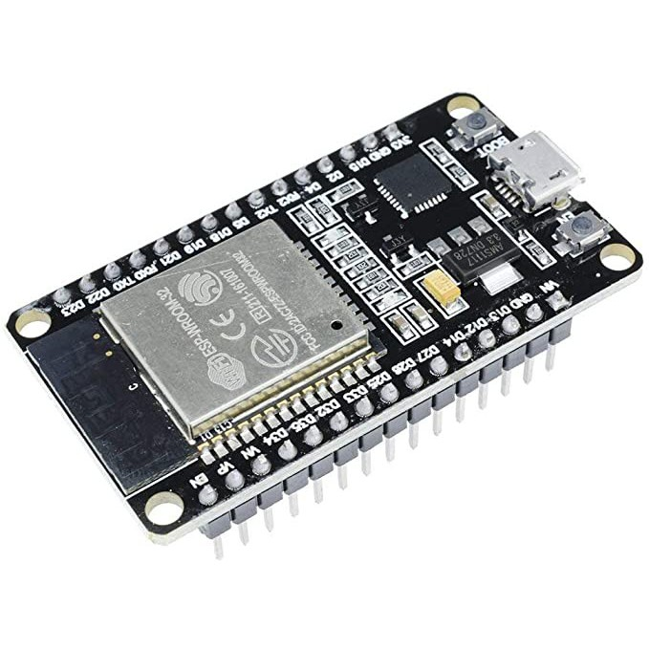
Direct control and buffered control

Slide 10
Direct control (direct to pin)
D1, D2, D3, D….

Slide 11
Buffered control (buffered to virtual pin)
V1, V2, V3, V…..

Slide 12
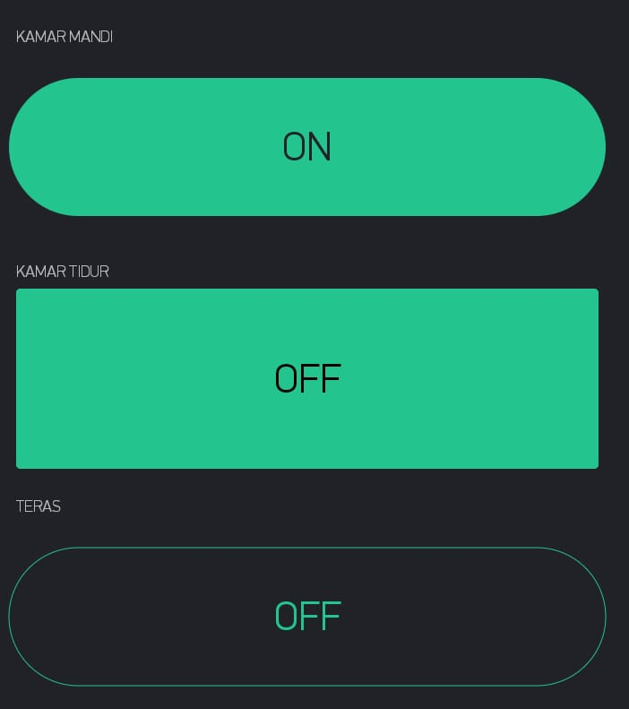
SMKDT’s IoT Expo layout benchmark
Stand 01 : Dorm Smart lamp (direct control)

Slide 13
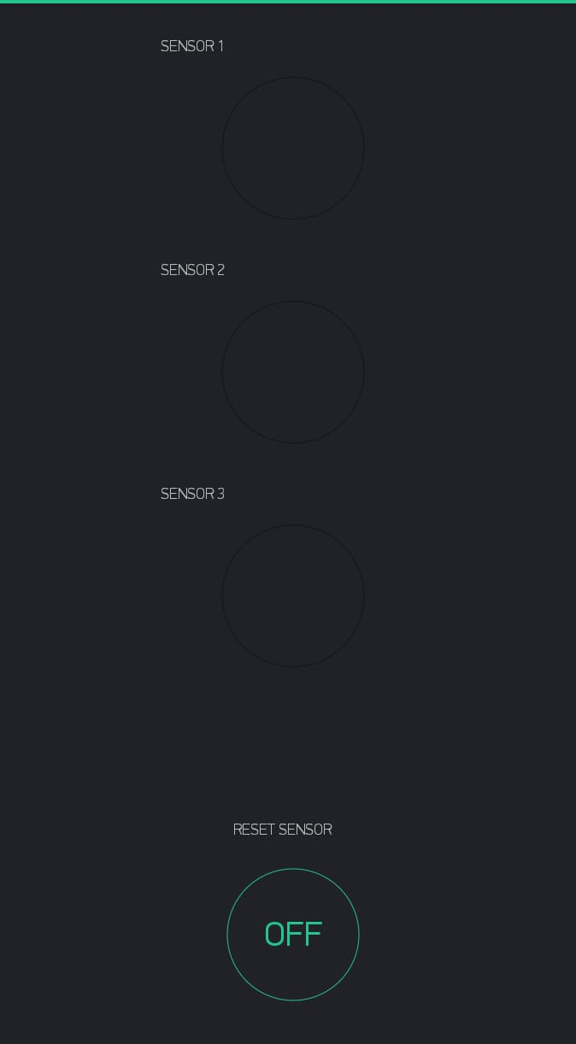
SMKDT’s IoT Expo layout benchmark
Stand 02 : Dorm windows smart security system (buffered control)

Slide 14
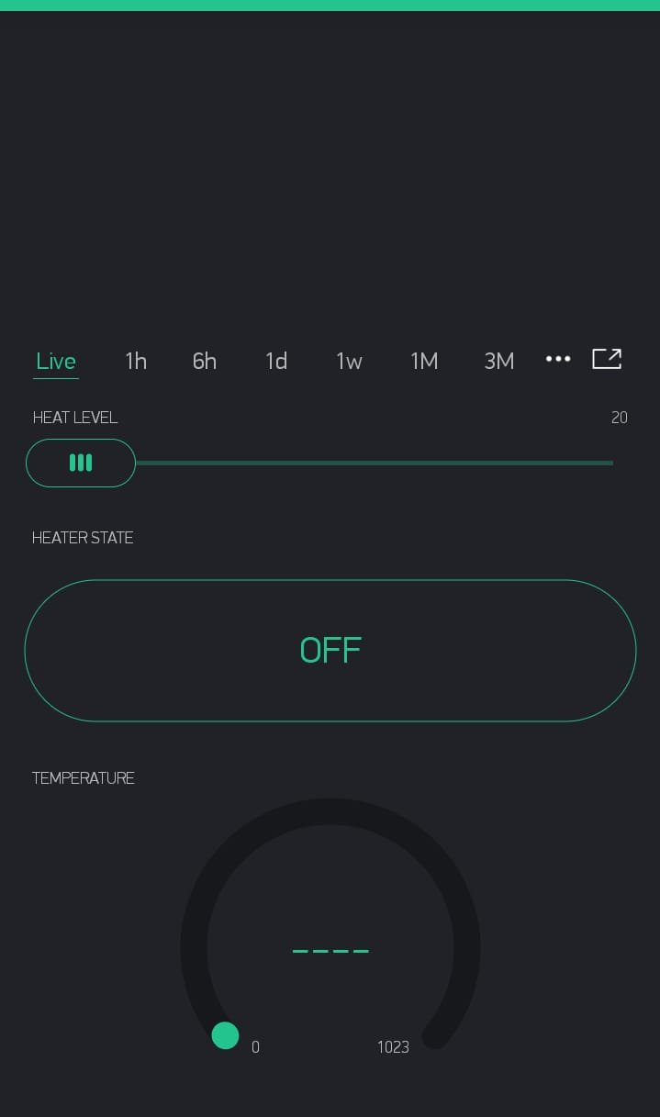
SMKDT’s IoT Expo layout benchmark
Stand 03 : Dorm smart water heater (buffered control)

Slide 15
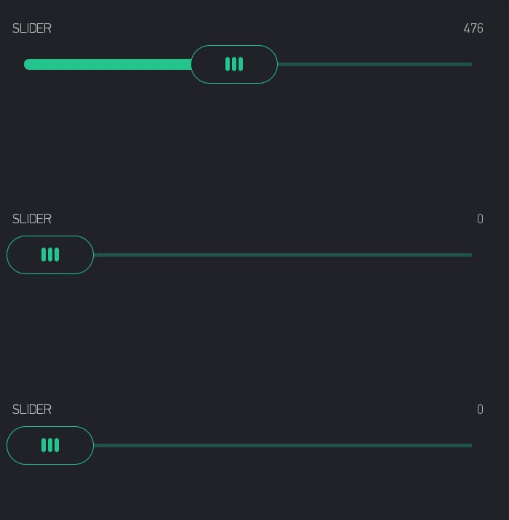
SMKDT’s IoT Expo layout benchmark
Stand 04 :Dorm smart Fan

Slide 16
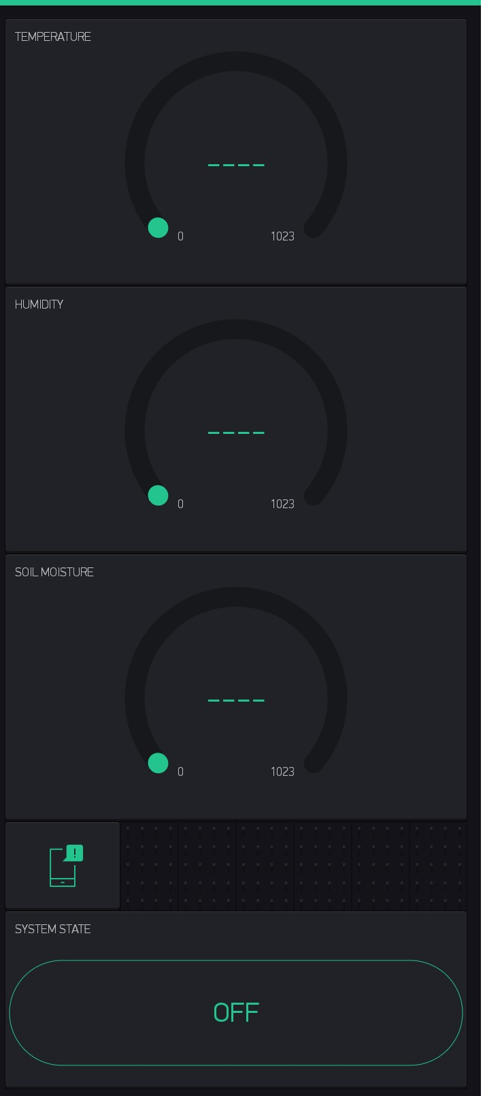
SMKDT’s IoT Expo layout benchmark
Stand 05 : Dorm Smart garden (buffered control)

Slide 17
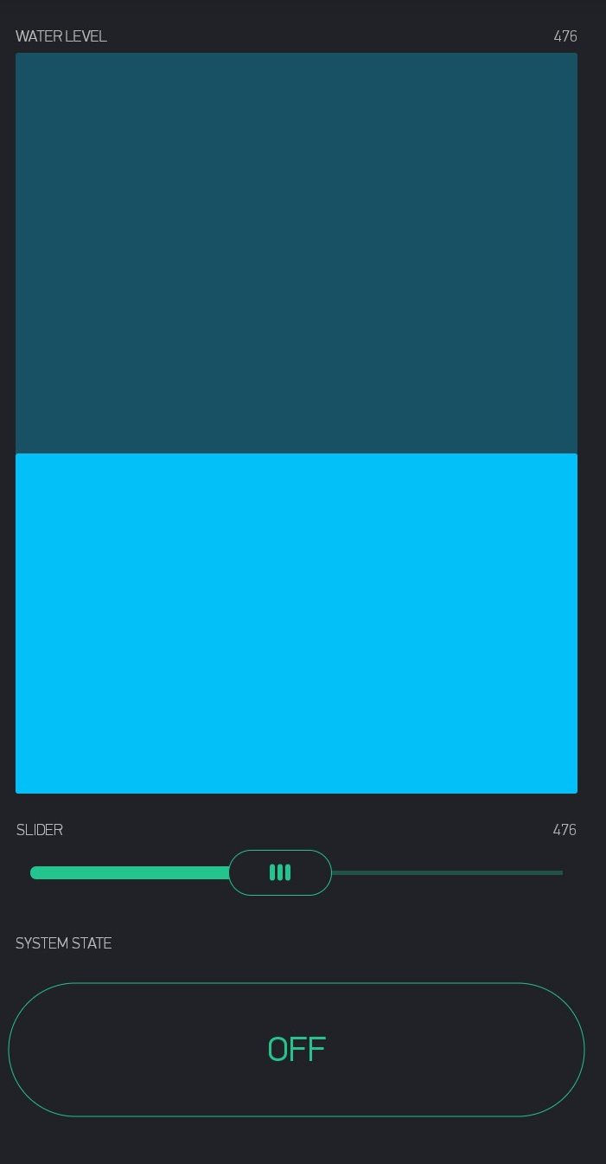
SMKDT’s IoT Expo layout benchmark
Stand 06 : Dorm smart water fill (buffered control)

Slide 18
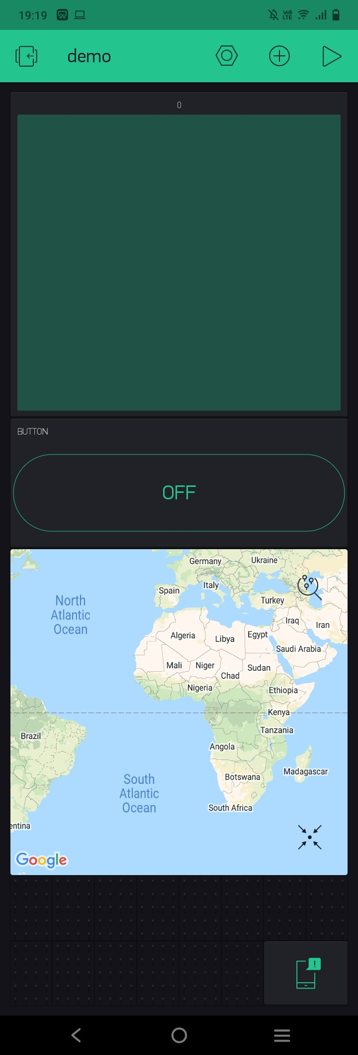
SMKDT’s IoT Expo layout benchmark
Stand 07 :Dorm smart Bin

Slide 19
Expo Group :
Group 1
Group 2
Group 3

